Slide 1
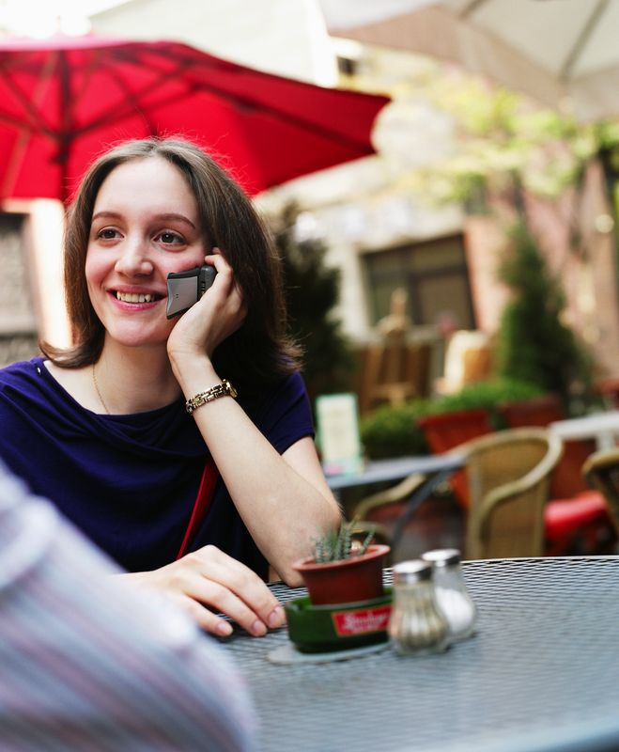

Do you like what you see in the mirror?
Female students are invited to participate in a research study designed to promote body acceptance.
All participants can receive up to $165 for attending 6 one-hour assessments to complete interviews and surveys.
Some participants will get to attend 4 one-hour classes designed to improve body image.
Body Image
For more information, visit the
Health Center or email
<facilitator’s e-mail address>

Slide 2
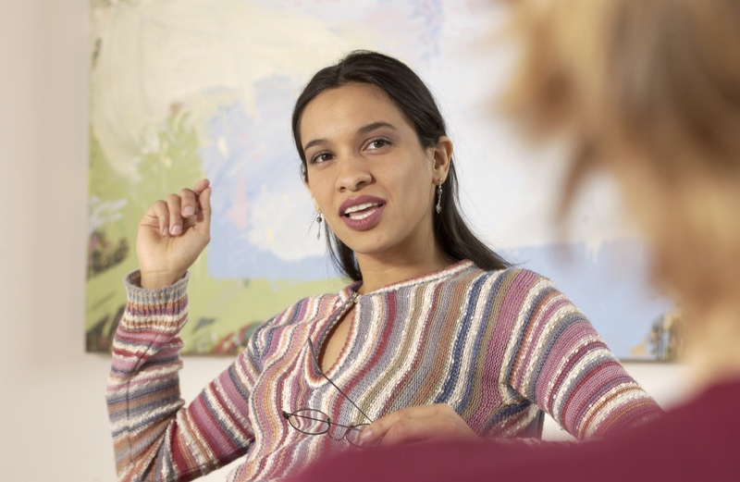
Do you like what you see in the mirror?
Body Image
Female students are invited to participate in a research study designed to promote body acceptance.
All participants can receive up to $165 for attending 6 one-hour assessments to complete interviews and surveys.
Some participants will get to attend 4 one-hour classes designed to improve body image.
For more information, visit the
Health Center or email
<facilitator’s e-mail address>

Slide 3

Do you like what you see in the mirror?
Body Image
Female students are invited to participate in a research study designed to promote body acceptance.
All participants can receive up to $165 for attending 6 one-hour assessments to complete interviews and surveys.
Some participants will get to attend 4 one-hour classes designed to improve body image.
For more information, visit the
Health Center or email
<facilitator’s e-mail address>

Slide 4
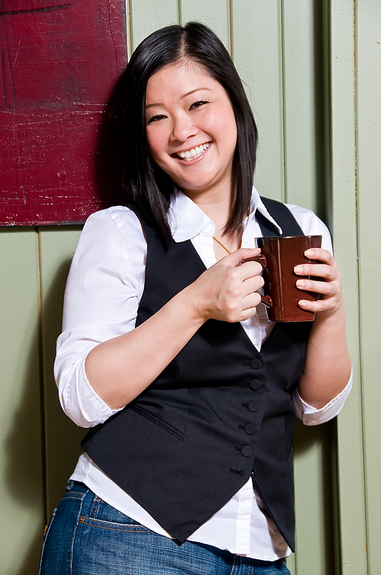
Do you like what you see in the mirror?
Body Image
Female students are invited to participate in a research study designed to promote body acceptance.
All participants can receive up to $165 for attending 6 one-hour assessments to complete interviews and surveys.
Some participants will get to attend 4 one-hour classes designed to improve body image.
For more information, visit the
Health Center or email
<facilitator’s e-mail address>
Be happy with your body!

Slide 5
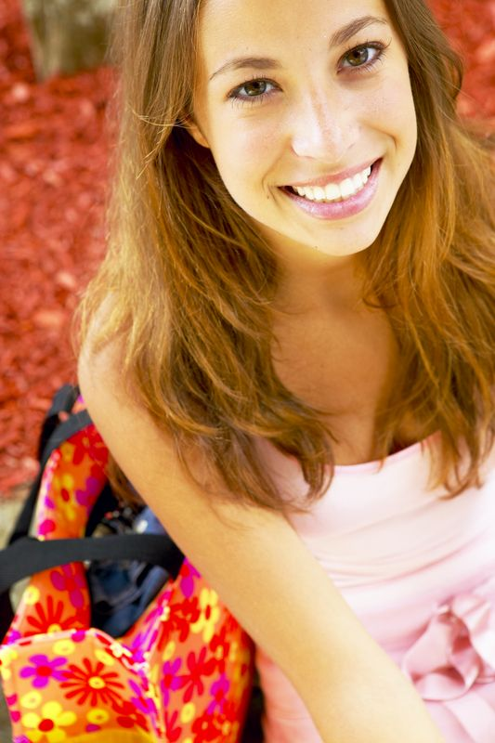
Do you like what you see in the mirror?
Body Image
Female students are invited to participate in a research study designed to promote body acceptance.
All participants can receive up to $165 for attending 6 one-hour assessments to complete interviews and surveys.
Some participants will get to attend 4 one-hour classes designed to improve body image.
For more information, visit the
Health Center or email
<facilitator’s e-mail address>
Be happy with your body!

Slide 6
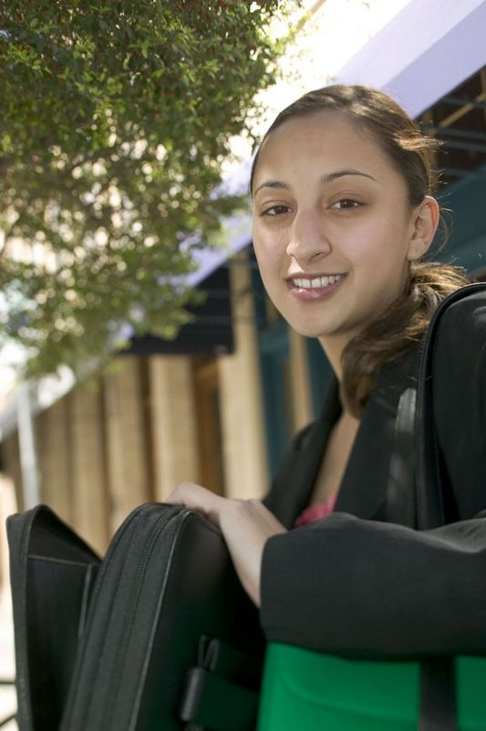
Do you like what you see in the mirror?
Body Image
Female students are invited to participate in a research study designed to promote body acceptance.
All participants can receive up to $165 for attending 6 one-hour assessments to complete interviews and surveys.
Some participants will get to attend 4 one-hour classes designed to improve body image.
For more information, visit the
Health Center or email
<facilitator’s e-mail address>
Be happy with your body!

Slide 7

Do you like what you see in the mirror?
Body Image
Female students are invited to participate in a research study designed to promote body acceptance.
All participants can receive up to $165 for attending 6 one-hour assessments to complete interviews and surveys.
Some participants will get to attend 4 one-hour classes designed to improve body image.
For more information, visit the
Health Center or email
<facilitator’s e-mail address>

